Slide 1
The Crisis in General Practice

Slide 2
Whole NHS in crisis
Nicholson £20 billion
Simon Stevens £30 billion
Abolishing market could save NHS £10 billion annually.

Slide 3
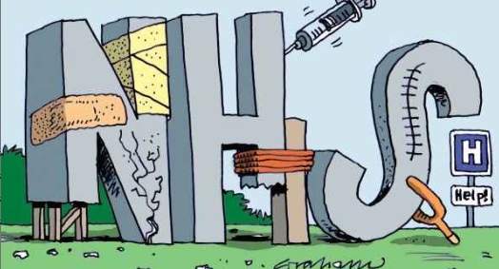

Slide 4
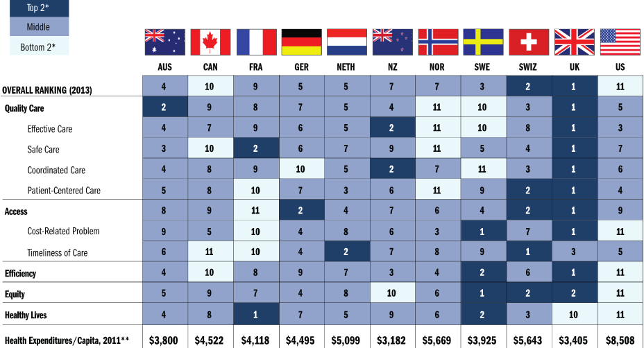
Commonwealth Fund Survey 2014

Slide 5
GP Workload
90% of NHS Consultations occur in General Practice over 300 million each year.
General Practice Funding is at an all time low of 8.3%

Slide 6
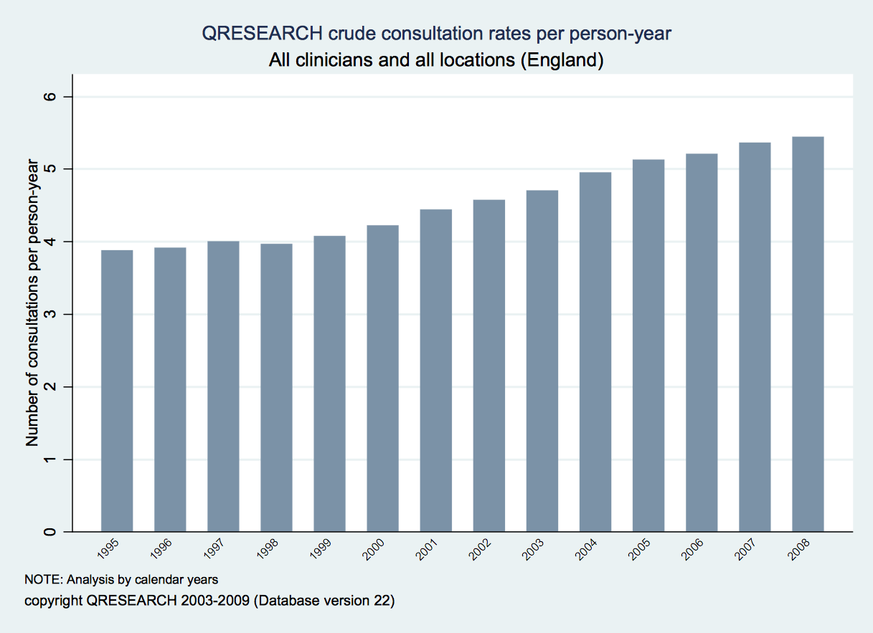
￼

Slide 7
GP Workload
Over 300 million GP consultations per year.
The average patient had 3.9 consultations each year in 1995 rising to 5.4 consultations each year by 2008.
Chronic disease management.
CQC
Care in the community/integrated care.

Slide 8
Workforce Crisis
GPs retiring early and emigrating
Applications for GP Training places down 15%
451 Training places unfilled.

Slide 9
Threats to GP Funding
MPIG
APMS practices
PMS review
Any Qualified Provider eg Sexual Health Services

Slide 10
Potential Consequences
Practices will have to reduce services to patients or even close.
More pressure on surrounding practices or AE.
“A threat to one is a threat to all.”
Private sector will swoop in.

Slide 11
Keep the pressure on!
Make the NHS the number one election issue.
Ed Miliband 8000 more GPs and £2.5 billion to NHS
David Cameron promises to ring fence NHS funding.

Slide 12
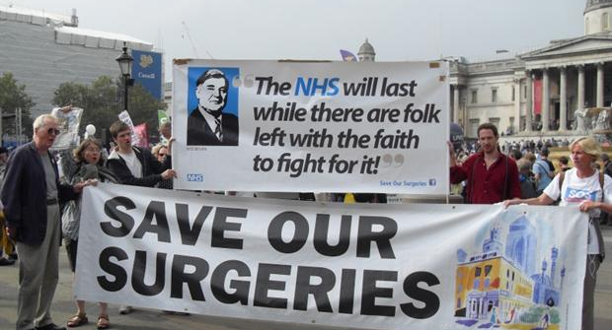
Save Our Surgeries.

